Slide 1

Chandigarh University
Department of Mathematics
B.Tech. CSE (Core/DS/IT/CC)
Semester-3
Subject Code:25MTT-202
Discrete Mathematics
Unit - 4 (Chapter- 4.1.1)
Dr. SARTAJ
DISCOVER . LEARN . EMPOWER

Slide 2

CO mappings

Slide 3

CO-PO mappings
Note: Degree of relevance/correlation: 1-Low, 2-Medium, 3-High, Blank or ‘- ‘- Nil

Slide 4
Topics Overview
Simple and Multigraph
Conclusions
Video links
References

Slide 5
Simple and Multiple Graph
Graph: Graphs are discrete structures consisting of vertices and edges that connect these vertices.
Mathematically, A graph G = (V , E) consists of V, a non-empty set of vertices (or nodes) and E, a set of edges.
Each edge has either one or two vertices associated with it, called its end points. An edge is said to connect its endpoints.
ns

Slide 6
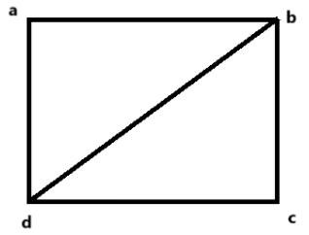
Simple and Multiple Graph
Example: In the graph
V = {a, b, c, d} is the vertex set
E = {{a, b}, {a, d}, {b, c}, {c, d}, {b, d}} is the set of edges.
Remark: An edge is said to be incident on its end points.
ns

Slide 7
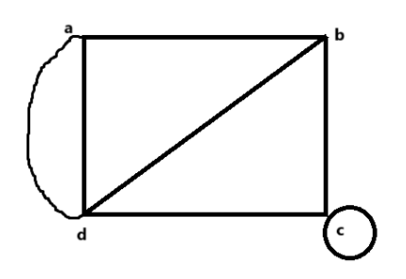
Simple and Multiple Graph
Parallel Edges: Parallel edges are two or more edges that connect the same pair of vertices in a graph.
Loop / Self Loop: A loop is an edge that connects a vertex to itself. In other words, a loop starts and ends at the same vertex.
Example: In the graph,
a and b are joined by two parallel edges
d has a loop.
ns

Slide 8
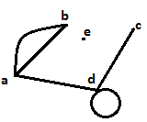
Order and Degree of Graph
Order of a graph: It is the total number of vertices in a graph. The order of the above graph is 4.
Degree of a vertex: The degree of a vertex v, denoted by δ(v) or d(v), is the number of edges incident on v.
Example: In this graph,
d(a) = 3, d(b) = 2, d(c) = 1,
d(d) = 4,d(e)=0.
ns

Slide 9
Order and Degree of Graph
Note:
Degree of a loop is taken as 2.
In a directed graph degree of a vertex is equal to the sum of the in degree and out degree where,
Out degree: No. of edges start from the vertex.
In degree = No. of edges terminate on the vertex.
ns

Slide 10
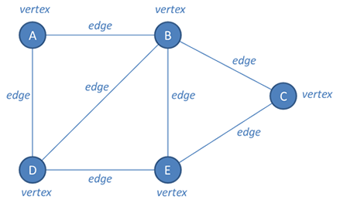
Order and Degree of Graph
deg(A)=2, deg(B)=4, deg(D)=3, deg(C)=2, deg(E)=3 and number of edges = 7
ns

Slide 11
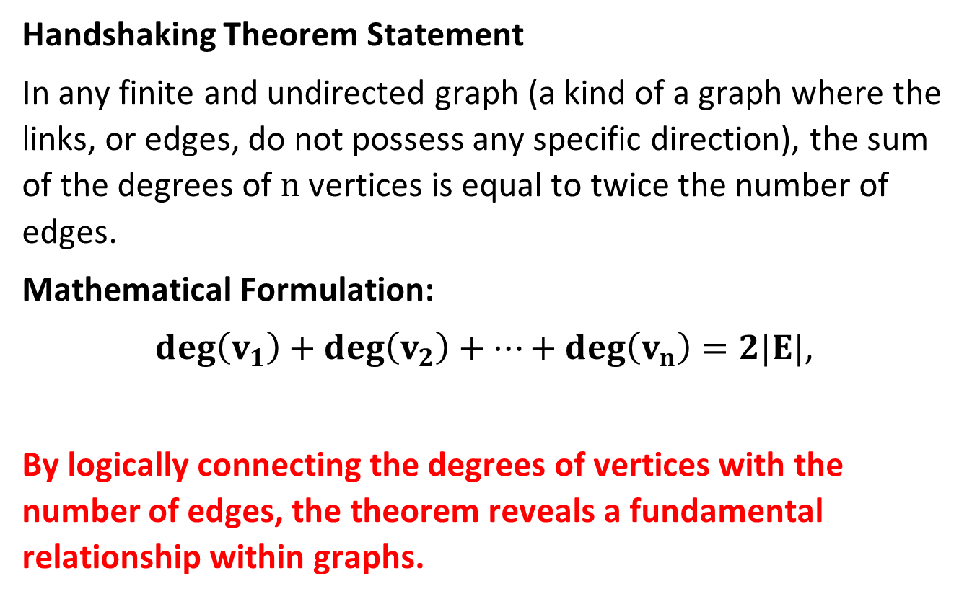
Handshaking Theorem Statement
Handshaking Theorem Statement
In any finite and undirected graph (a kind of a graph where the links, or edges, do not possess any specific direction), the sum of the degrees of $n$ vertices is equal to twice the number of edges.
Mathematical Formulation:
$deg\left(v_{1}\right)+deg\left(v_{2}\right)+…+deg\left(v_{n}\right)=2|E|$,
By logically connecting the degrees of vertices with the number of edges, the theorem reveals a fundamental relationship within graphs.
ns

Slide 12
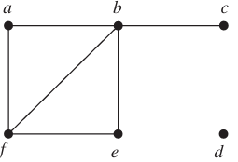
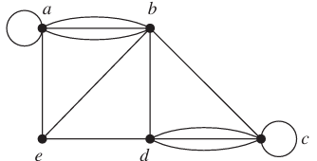
Activity-1
Find the no. of vertices and edges, degree of each vertex in the given graphs. Identify all multiple edges, loops, adjacent vertices, adjacent edges, isolated and pendant vertices.
(1)
(2)

Slide 13
Activity-2
Question 1: How many edges are there in a graph with 10 vertices each of degree 2?
Question 2: In a complete graph with 𝑛 vertices, use the Handshaking Theorem to find the total number of edges.
Question 3. If a graph has 6 vertices with degrees 3, 2, 2, 1, 4, 2. Is this a valid graph?
Question 4.In a graph with 8 vertices, 5 vertices have odd degrees. Can this be possible? Why or why not?
Question 5. A graph has 10 edges. What is the sum of all vertex degrees?

Slide 14
Conclusion
Types of Graph, degree and Order are discussed.
Handshaking Theorem is discussed.
Related examples and applications are given.
ns

Slide 15
Video Links
https://youtu.be/E40r8DWgG40?si=HM799le2HxgotZaf
https://youtu.be/j3lrgY_sH44?si=RHcyCOoz3itig_RY
(Video Links)
https://drive.google.com/file/d/1zm_o2dthNGIi-OXsgP8McUz4SUlb9q3p/view?usp=sharing
(Book Link)

Slide 16
References
Sr. No. | Author | Name of the Book | Publisher | Year of Publication
1 | Kenneth H. Rosen | Discrete Mathematics and Its Applications | McGraw-Hill | 2019
2 | C. L. Liu | Elements of Discrete Mathematics | McGraw-Hill | 1996
3 | J. P. Tremblay, R. Manohar | Discrete Mathematical Structures with Applications to Computer Science | Tata McGraw Hill | 2001
4 | Kolman, Busby, Ross | Discrete Mathematical Structures | PHI | 2001
5 | Narsingh Deo | Graph Theory with Applications to Engineering and | PHI | 2017

Slide 17
Thanks!!!

